Slide 1
Macroeconomic Modelling: Types of Models used for Policy Analysis
Cambridge Econometrics Training Course
Hector Pollitt
September 2015
Notes:
Not forecasting

Slide 2
Why use macroeconomic modelling?
It is usually not possible to carry out experiments at macroeconomic level
Computer-based modelling is a component of the ‘next best alternative’ approach
All models provide a simplification of reality; however, the assumptions made in the simplification process must be realistic!
Notes:
Provide the usual quote from Sean Holly

Slide 3
Introduction
“Good modelling involves the combination of best econometric practice, coherent economic theory and knowledge of data. Inevitably conflicts can arise between these three factors, and the modeller will need to exercise judgement in the weight that is attached to the econometric evidence, its consistency with theory and the requirement to model properly the time series observations”
Sean Holly (2013)

Slide 4
Outline
Definitions
Thoughts on CGE and macro-econometric approaches
Other modelling approaches
  IAMS
  Agent-Based models
Various key issues

Slide 5
General and Partial Modelling
General models cover the whole economy
Partial models focus on a single sector, or a small group
In Europe, the main general models include:
  GEM-E3, E3ME, Worldscan, GINFORS

Slide 6
Top-down and Bottom-up Modelling
These terms mean different things in different areas of modelling
In energy modelling:
  bottom-up models are specified by technology, they typically come from an engineering background
  top-down models are based on economic relationships
As it is not possible to define all technologies explicitly, bottom-up models are partial

Slide 7
Types of General Economic Model
Macro Models
CGE
DSGE
VAR
Unrestricted VAR
SVAR
Cointergrating SVAR
Econometric
SEMs
Input-output
RBC
Notes:
If you designed a model today it would probably be a conintergrating unrestricted VAR. But because creating new models is a very lengthy and expensive process the older methods are largely still in use today.

Slide 8
Types of partial model
They are often referred to as partial equilibrium models
Transport:
  Trans-tools is a network model
  Tremove considers vehicle fleets, ASTRA links to economy
Energy:
  PRIMES is an energy systems model that is highly detailed
  POLES, TIMES, MESSAGE are other examples
Agriculture and land use:
  IMAGE and GLOBIOM are widely used to assess land use
  CAPRI is used for agricultural analysis

Slide 9
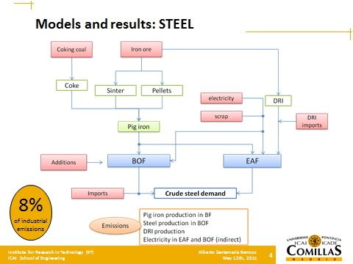
Industrial Models?
Santamaria and Linares (2011) http://www.iit.upcomillas.es/docs/IIT-11-090A.pdf
Notes:
SB

Slide 10
Equilibrium and Non-Equilibrium
There are several different ways of characterising this distinction:
  supply or demand driven
  long or short term
  theoretical or empirical
Not all are completely accurate, especially now as the two approaches are coming closer together

Slide 11
Equilibrium and Non-Equilibrium (cont.)
In the 1960s and 1970s the macroeconometric approach dominated
Holly (2013) provides eight reasons for a ‘backlash’ against the approach:
  neglect of monetary influence
  the Lucas Critique and rational expectations
  lack of micro-foundations
  the Sim’s critique of macro-modelling
  inadequate treatment of error processes
  failure to use insights from optimal control theory
  time-inconsistency of discretionary policy
  ideological opposition to government ‘control’
The focus of research moved to CGE approaches

Slide 12
Examples of models in Europe
Equilibrium
Non-Equilibrium
GEM-E3*
WorldScan*
E3ME*
GINFORS*
General
Partial
PRIMES (energy)
TIMES (energy)
ASTRA (transport)
POLES (energy)
* These models cover the World, including Europe

Slide 13
Treatment of Supply and Demand?
This is a question of whether the constraint on output comes from the supply side capacity (CGE) or from the level of effective demand (macroeconometric)
It is closely linked to the issue of how prices are formulated and the efficiency of markets
It is therefore also closely linked to underlying assumptions about how markets work (efficiently in CGE models, how they did in the past in econometric models)

Slide 14
Long and Short-Term Analysis?
In conceptual terms the distinction is linked to the ‘neo-classical synthesis’:
  aggregate demand may be a short-run constraint
  but long-term growth rates determined by supply-side factors
Attempts have been made to create CGE models suitable for short-term assessment (DSGE)
  these are now widely used in central banks
Modern econometrics largely supports long-run analysis

Slide 15
Theoretical and Empirical?
This distinction can also be exaggerated somewhat:
  most CGE models incorporate econometric estimates in their elasticities, although the treatment of prices is still theoretical
  econometric models are ‘statistical’ in the way their parameter coefficients are derived, but the choice of parameters depends on basic economic theory

Slide 16
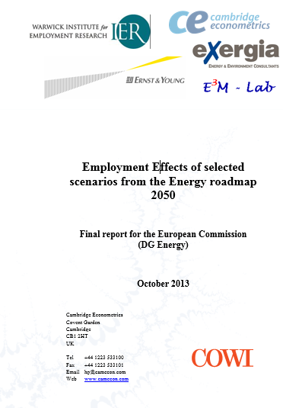
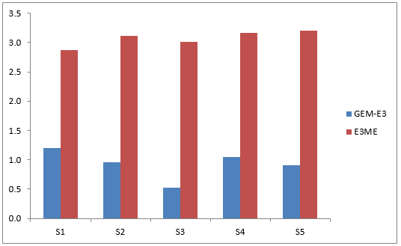
The differences in practice…
High energy efficiency
High RES
Delayed CCS and low nuclear cases
Diversified
Source: Employment Effects of the Energy Roadmap, Cambridge Econometrics et al (2013)
Figure shows % change in employment from baseline, 2050

Slide 17
Integrated Assessment Models
This is a general term that refers to two types of modelling:
  large-scale linking of models, as carried out for the IPCC
  single and relatively simple models that are used to calculate the ‘social cost of carbon’
Examples of the first include:
  IMAGE (PBL, the Netherlands)
  GCAM (PNNL, US)

Slide 18
Model Linkages
Energy
Systems
Model
Integrated
Assessment
Model
Climate
Model
E3 Model
Economy
Economy
Economy
Economy
Energy
Energy
Energy
Energy
Emissions
Emissions
Emissions
Emissions
Climate
Climate
Climate
Climate
Cambridge Econometrics and SERI (2011), for DG Environment, EC.
Notes:
Model linkages to be discussed in the next session

Slide 19
E3ME as an IAM
Through work with the University of Cambridge, E3ME is being linked to versions of:
  the FTT energy systems tool (now standard)
  climate and carbon cycle models (already done)
  land use modelling (being tested)
The ultimate aim is to develop the world’s first simulation-based IAM

Slide 20
Small-Scale IAMs
Examples include RICE/DICE, FUND, PAGE
They include a very simple economic module (usually CGE with no sectors), with energy and climate modules and an economic damage function

Slide 21
Criticisms of IAMs
Recent severe criticism from Pindyck (2013) and Stern (2013)
Key criticisms include:
  arbitrary nature of the economic damage functions
  sensitivity to discount rates and other assumptions
  assumption of exogenous growth
  extrapolations beyond the available data

Slide 22

Agent-Based Models
Developed from evolutionary economics
Brought to attention by Beinhocker (2006)
Most applications are still micro-based, but interest and research are growing
  e.g. adoption of new technology, including scale and networking effects
The Economist, 2010

Slide 23
Modelling Issues
The Lucas Critique
Treatment of technology
Finance
Labour markets
Non-linearities
Treatment of uncertainty

Slide 24
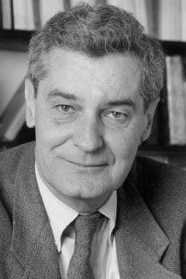
The Lucas Critique
A specific example of the more general issue that behavioural relationships that are fixed in economic models may change over time and circumstances
Applies to both modelling approaches but usually applied to econometric modelling
The critique was formed before current econometric theory was developed but is still applicable to some extent

Slide 25
Treatment of Technology
It is now generally accepted that technology should be endogenous in modelling
There are two ways of doing it
  explicitly (bottom-up, partial approaches)
  implicitly (top-down, general approaches)
There will always be a limitation that it is not possible to predict all future technologies

Slide 26
Treatment of Finance
CGE models assume ‘money neutrality’, meaning that a change in the money supply has no real economic impacts
Post-Keynesian models may allow for ‘endogenous money’ – when commercial banks extend loans they increase the money supply, which may impact on aggregate demand

Slide 27
Treatment of Labour Markets
Most models now incorporate unemployment in some form (voluntary or involuntary)
But labour types are rarely differentiated, except possible high/low skilled
Macro models therefore struggle to deal with skills shortages and similar issues

Slide 28
Non-Linearities
This could refer to:
  relationships that are in general not linear
  threshold effects or tipping points
  asymmetries
All models provide approximations…
  general models typically assume (log-)linearity
  partial models may be able to take this into account better
But the principles behind the Lucas Critique are especially prevalent here

Slide 29
Treatment of Uncertainty
This cuts across all the modelling approaches
At present, most still provide point estimates, with only a very basic treatment of uncertainty
  see e.g. treatment of climate models
This is recognised as an issue in the community

Slide 30
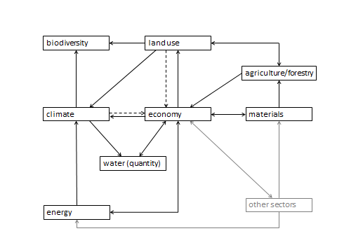
Current Trends (1) – Wider Coverage
Cambridge Econometrics and SERI (2011), for DG Environment

Slide 31
Current Trends (2) – More Detailed Sub-models
Cambridge Econometrics and SERI (2011), for DG Environment

Slide 32
Current Trends (3) – Better Treatments
Equilibrium and non-equilibrium modelling approaches learning from each other
  e.g. better treatment of labour markets
Other improvements and developments ongoing

Slide 33
Current Trends (4) – New Approaches
Interdisciplinary work
Agent-based models
Behavioural economics
New data sources
Online and networking, cloud computing
…?

